Slide 1

Navigating the R Package Universe
John C. Nash Telfer School of Management University of Ottawa nashjc@uottawa.ca
Julia Silge Stack Overflow julia.silge@gmail.com
Spencer Graves EffectiveDefense.org spencer.graves@effectivedefense.org
Ludovic Vannoorenberghe DataCamp ludo@datacamp.com

Slide 2
Background
JN
Initial name "Navigating the R package jungle"
Jungles -- rain forests -- are places rich in resources.
more than 10 000 packages in CRAN
many vignettes and Blogs
more stuff in Bioconductor, Github, and other collections
Resources are often difficult to find
Forest is usually hard to navigate
Navigating R Packages | useR! Brussels

Slide 3
Some responses to the challenge
JN
Wrappers -- packages that unify the call to a number of resources for a common set of tasks (JN)
Task Views -- Guidance on resources and how their development, timeliness and accessibility can be improved (JS)
Search -- improving how users can find the tools they need and information on how to use them effectively and efficiently
The “sos” package (SG)
Rdocumentation (LV)
RStudio CRANsearcher
MORE – you!

Slide 4
Unifying packages
JN
Best seen via an example: "optimization" (function minimization)
optim(), nlm() and nlminb() in base R
quite large number of individual packages: BB, dfoptim, Rcgmin, Rvmmin, Rtnmin, lbfgs, lbfgs3, trust, trustOptim, nloptr, minqa, powell, and others
MANY and DIFFERENT calling sequences
MANY control parameters, some with same name but different function, others with different names for same functionality

Slide 5
Unifying packages
JN
Response: package optimrx (prev. optimx)
function optimr() uses optim() calling sequence with more choices for "method="
ongoing development
extra functions opm(), multistart(), polyopt()

Slide 6
Other unification efforts
JN
gloptim (Hans Werner Borchers) global / stochastic optimization
bbmle (Ben Bolker) some integration of tools for maximum likelihood estimation
jmv (Jamovi) (Jonathan Love) attempts to integrate many common statistical tests
Have I missed good examples? Let me know! (nashjc _at_ uottawa.ca)

Slide 7
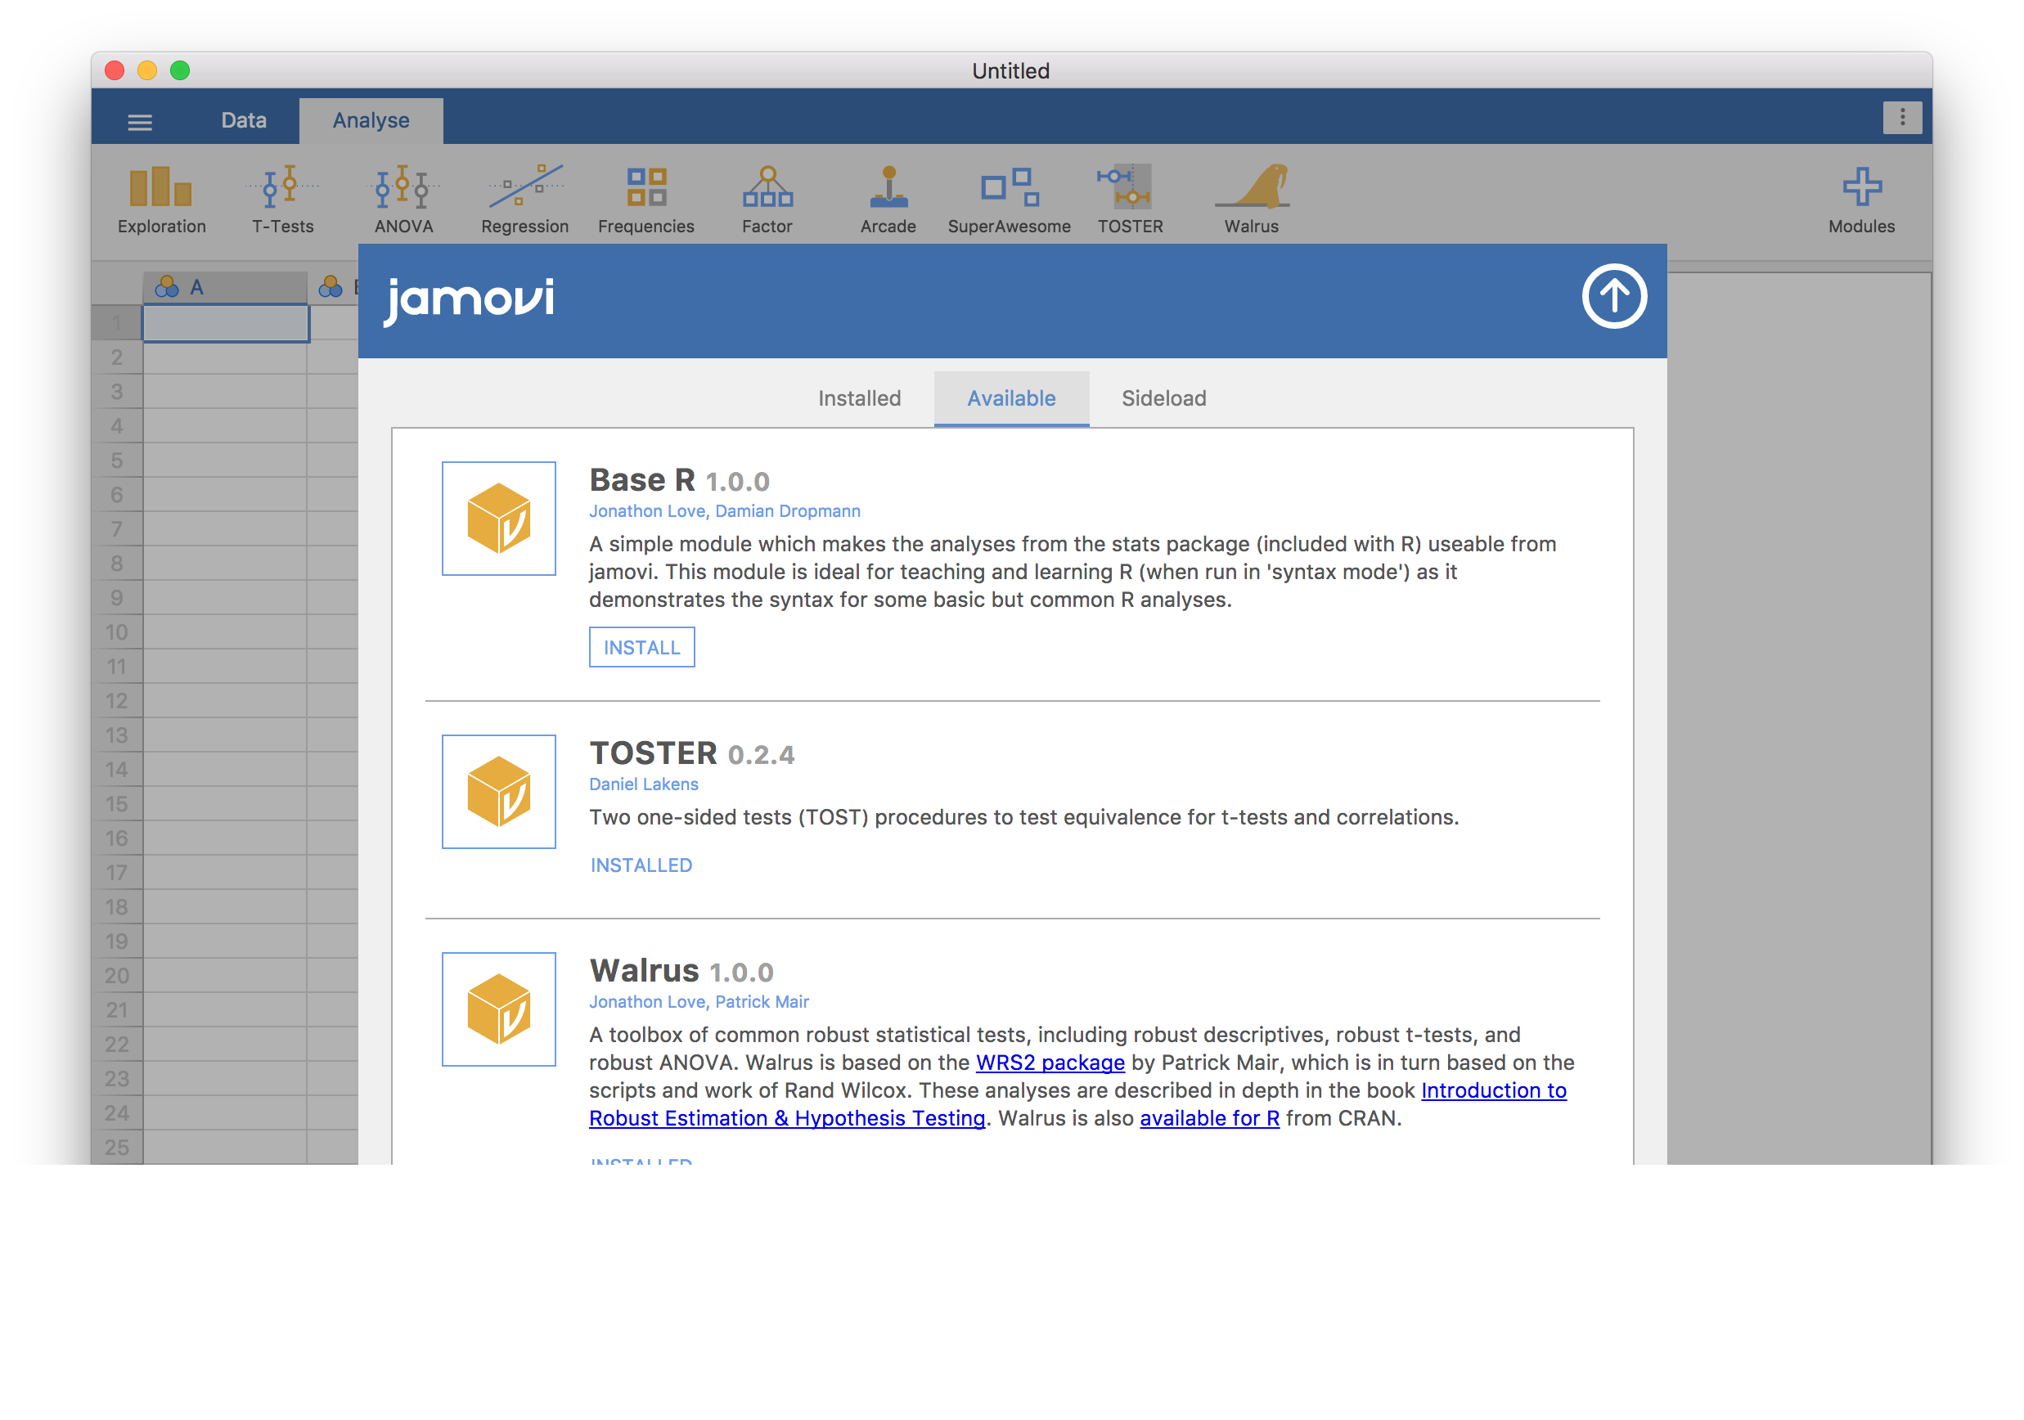
Other unification efforts
JN
jamovi is a graphical spreadsheet for R
(Jonathan Love will be presenting at 11:36 on the thursday)

Slide 8
Opportunities for unification?
JN
Principal Components / svd -- (JN and Claudia Beleites) https://gitlab.com/nashjc/svdpls
Nonlinear modeling -- better integration of nls(), packages **nlsr**, **nls2** and **minpack.lm**, though the gains may be small
Are there opportunities to simplify or streamline the user experience with database access? With data manipulation and display (plyr, dplyr, tables, others)?
Navigating R Packages | useR! Brussels

Slide 9
Opportunities to highlight or conceal packages
JN
Do we need to see a list of all packages as a default in CRAN?
Lists by task or application?
Lists by "popularity" of call? (Paul Gilbert 2piQA)
Hide "infrastructure" packages from general users
Omit some "junk" from the streamlined lists
Note that such lists can be external to CRAN, i.e., wrappers
Navigating R Packages | useR! Brussels

Slide 10
Where to now?
JN
Form groups to identify opportunities in unification, guidance or search
Encourage/start projects to actually try out ideas
Note Google Summer of Code and R Foundation initiatives
https://github.com/nashjc/Rnavpkg/
https://github.com/nashjc/Rnavpkg/wiki
Navigating R Packages | useR! Brussels

Slide 11
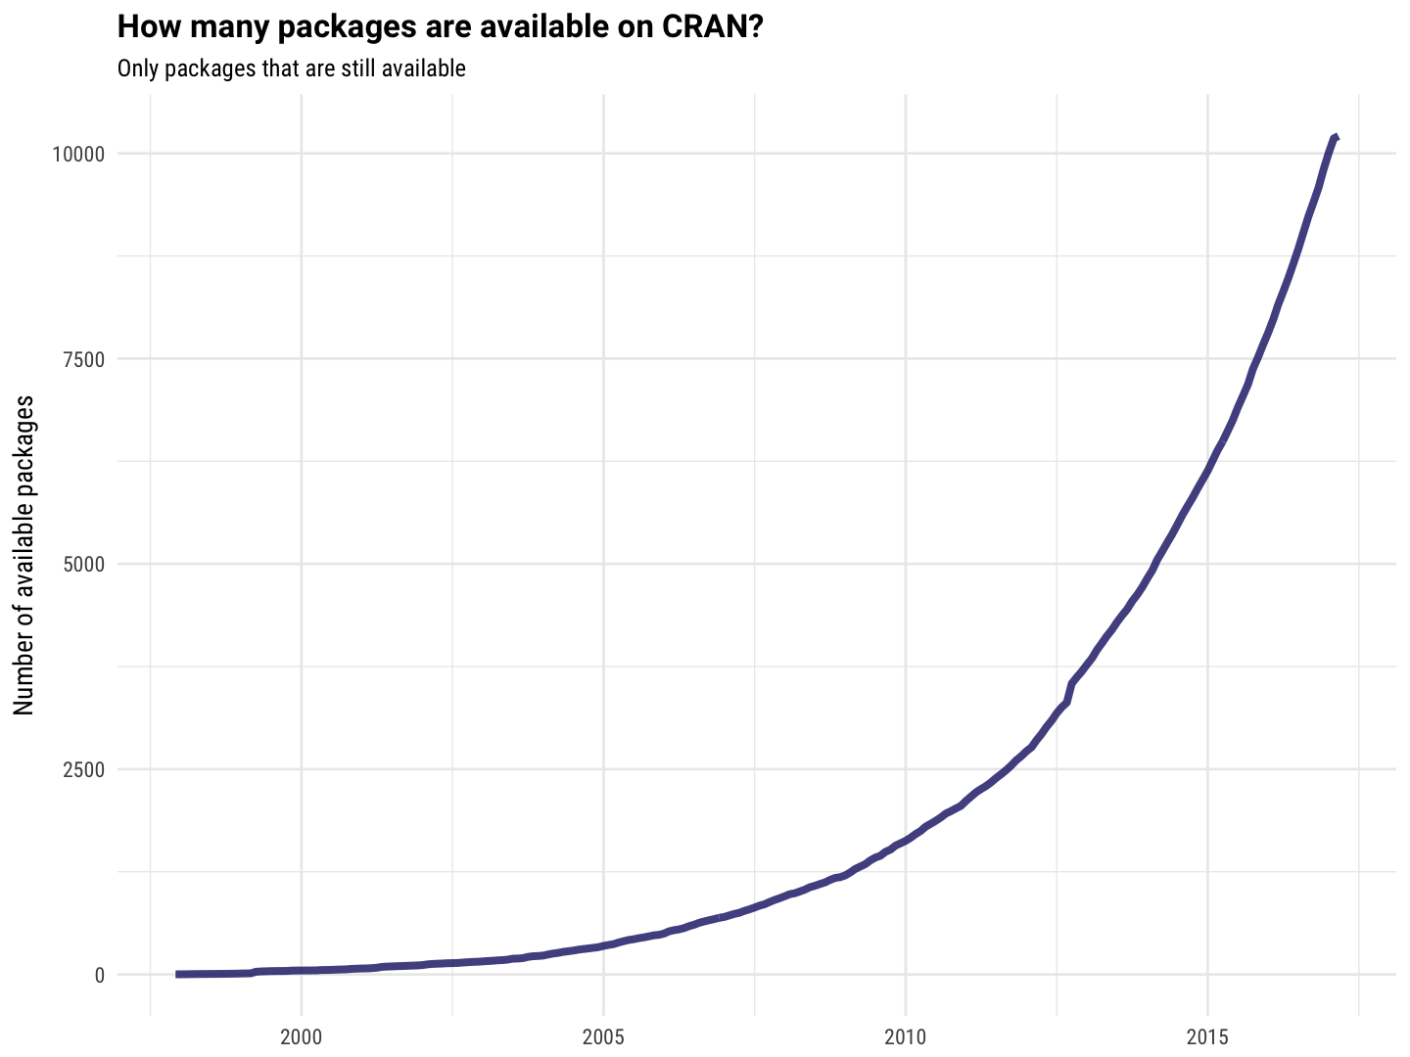
Packages on CRAN
JS

Slide 12
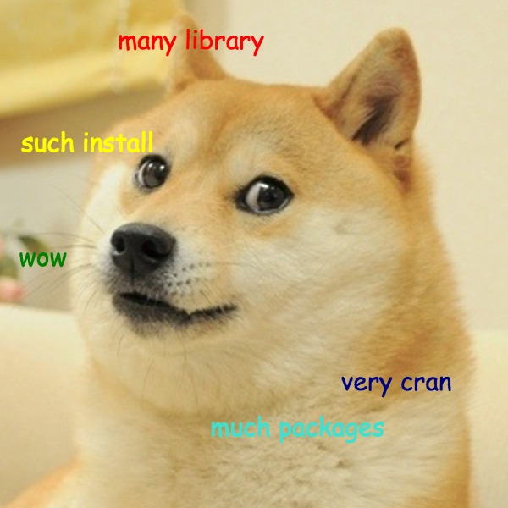
JS

Slide 13
GOOD NEWS
BAD NEWS
JS

Slide 14
What this means for R users
JS
There are many resources out there for many differents kinds of tasks
It can be difficult to find what you are looking for
Assessing quality can be a challenge
Navigating R Packages | useR! Brussels

Slide 15
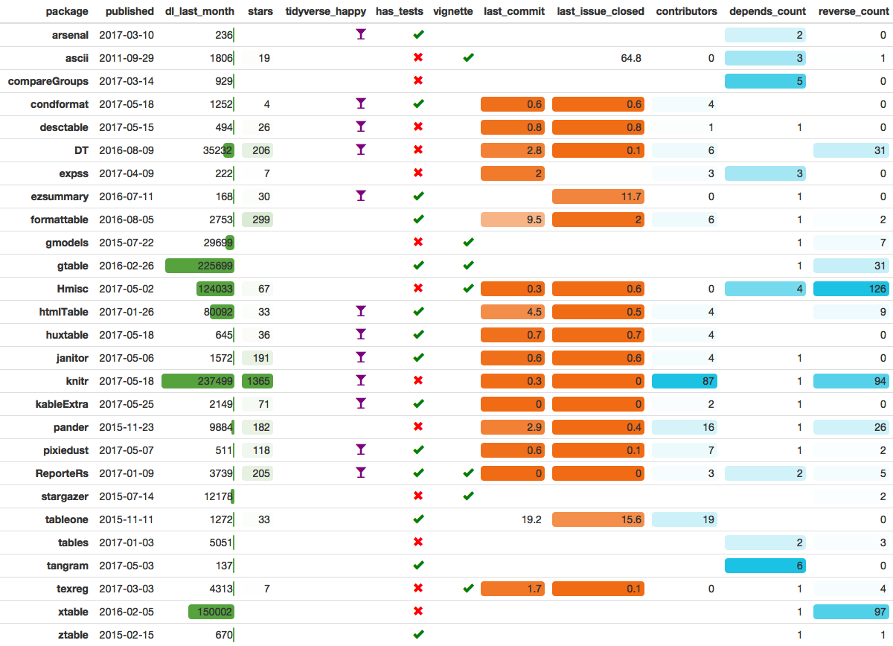
JS
Notes:
packagemetrics package

Slide 16
What this means for package developers
JS
Most R users are open to trying out new packages
There are so many packages that it can be difficult to connect with your audience
Navigating R Packages | useR! Brussels

Slide 17
What is a CRAN Task View?
JS
Let's check out the Task Views right now
Let’s look at this Shiny app from Mikhail Popov
Navigating R Packages | useR! Brussels

Slide 18
CRAN Task Views (CTV),
the UNOFFICIAL VERSIONS
JS
Sometimes package developers and users put together Task Views on their own
Check out Ben Marwick’s archeology CTV or Thomas Leeper’s open data CTV
Navigating R Packages | useR! Brussels

Slide 19
What this means for Task View maintainers
JS
Making (and keeping!) a Task View useful can be a challenge
Task Views vary in how helpful and up-to-date they are
Could more CTVs move to being maintained on GitHub or a Wiki?
Two possible approaches for CTVs + GitHub
Editing a markdown file and using makefiles to get to XML
Editing XML and using a pretty simple script to get to markdown
Navigating R Packages | useR! Brussels

Slide 20
How do people find packages now?
JS
Notes:
Other things people suggested: CRANberries, crantastic RSS feed, Stack Overflow answers, rdocumentation.org and rpackages.io, reading other people’s code,

Slide 21
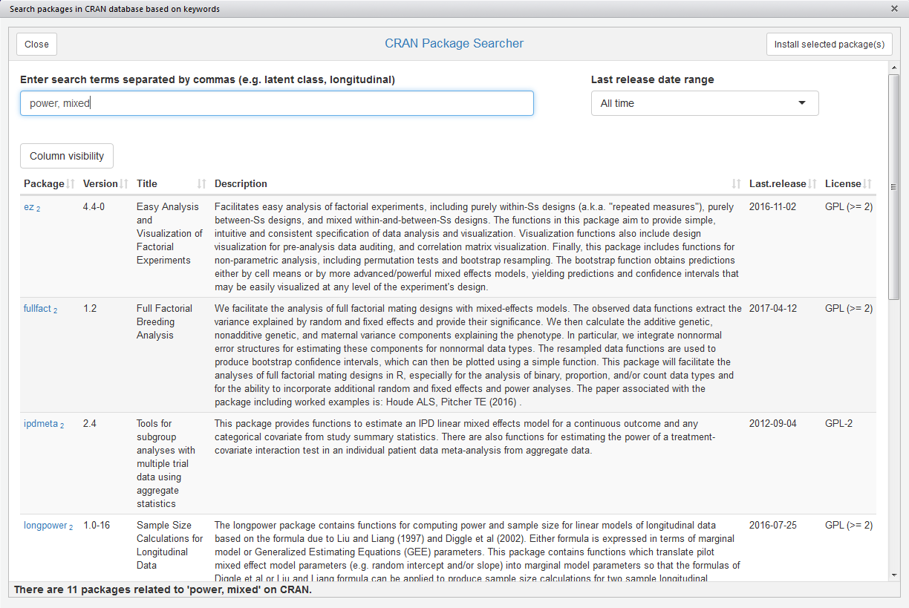
CRANsearcher
JS
RStudio add-in to search CRAN packages based on keyword(s)
Navigating R Packages | useR! Brussels
Notes:
Web-based resources can distract away from RStudio and interrupt your workflow Existing tools allow search of package names, but the description is rich with information CRAN task views capture the highlights, but are not updated in real time RStudio add-in tool for searching & exploring packages

Slide 22
CRANsearcher
JS
Install from CRAN: install.packages("CRANsearcher")
Functionality
Search CRAN database based on keyword(s)
Searches the package name, title, and **description**
Filter by most recent release date
Link to websites to learn more
Install selected package(s) with the click of a button
Navigating R Packages | useR! Brussels

Slide 23

CRANsearcher
JS
GitHub: https://github.com/RhoInc/CRANsearcher
Authors:
Agustin Calatroni, Rho, Inc.
Becca Krouse, Rho, Inc.
Navigating R Packages | useR! Brussels

Slide 24
Are you an R User?
Are you a package developer?
JS
Notes:
CRAN Task views are out there, other tools for search and discovery are also available, be engaged with global R community
Task View maintainers are often open to suggestions about improving TVs, keep in mind *how* users learn about pkgs, be engaged with global R community

Slide 25
sos::findFn
SG
Searches the “RSiteSearch” database for matches in help pages
Sorts the results to put first the package with the most matches
writeFindFn2xls to produce a package summary
required installing packages locally to get some of the information needed
Not well known
Navigating R Packages | useR! Brussels

Slide 26
sos::findFn
SG
library(sos)
findFn('your search term')
development version opens two web pages for
help pages
packages
Navigating R Packages | useR! Brussels

Slide 27
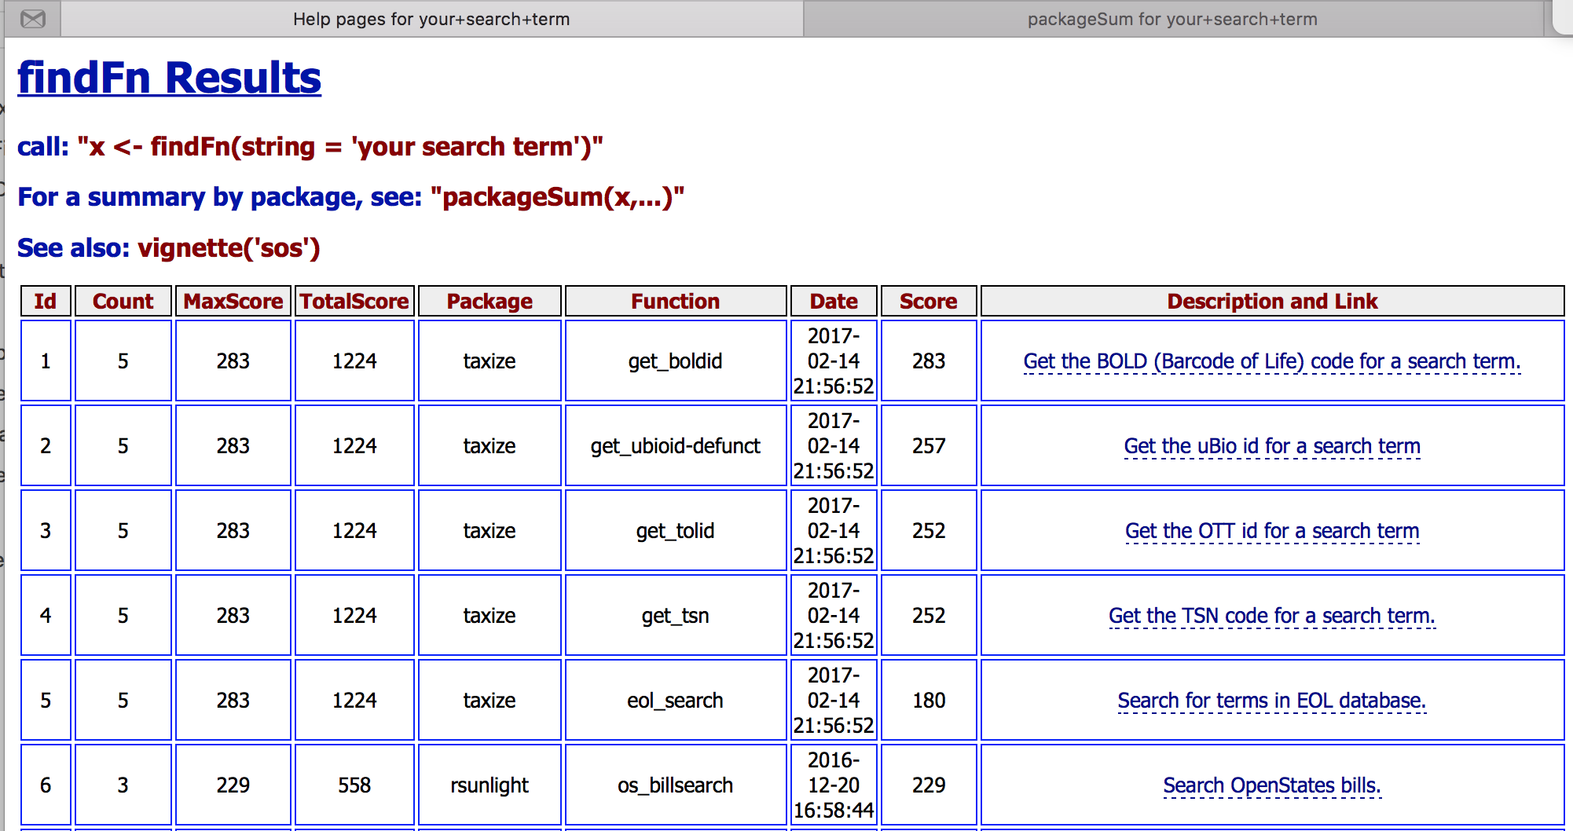
SG

Slide 28
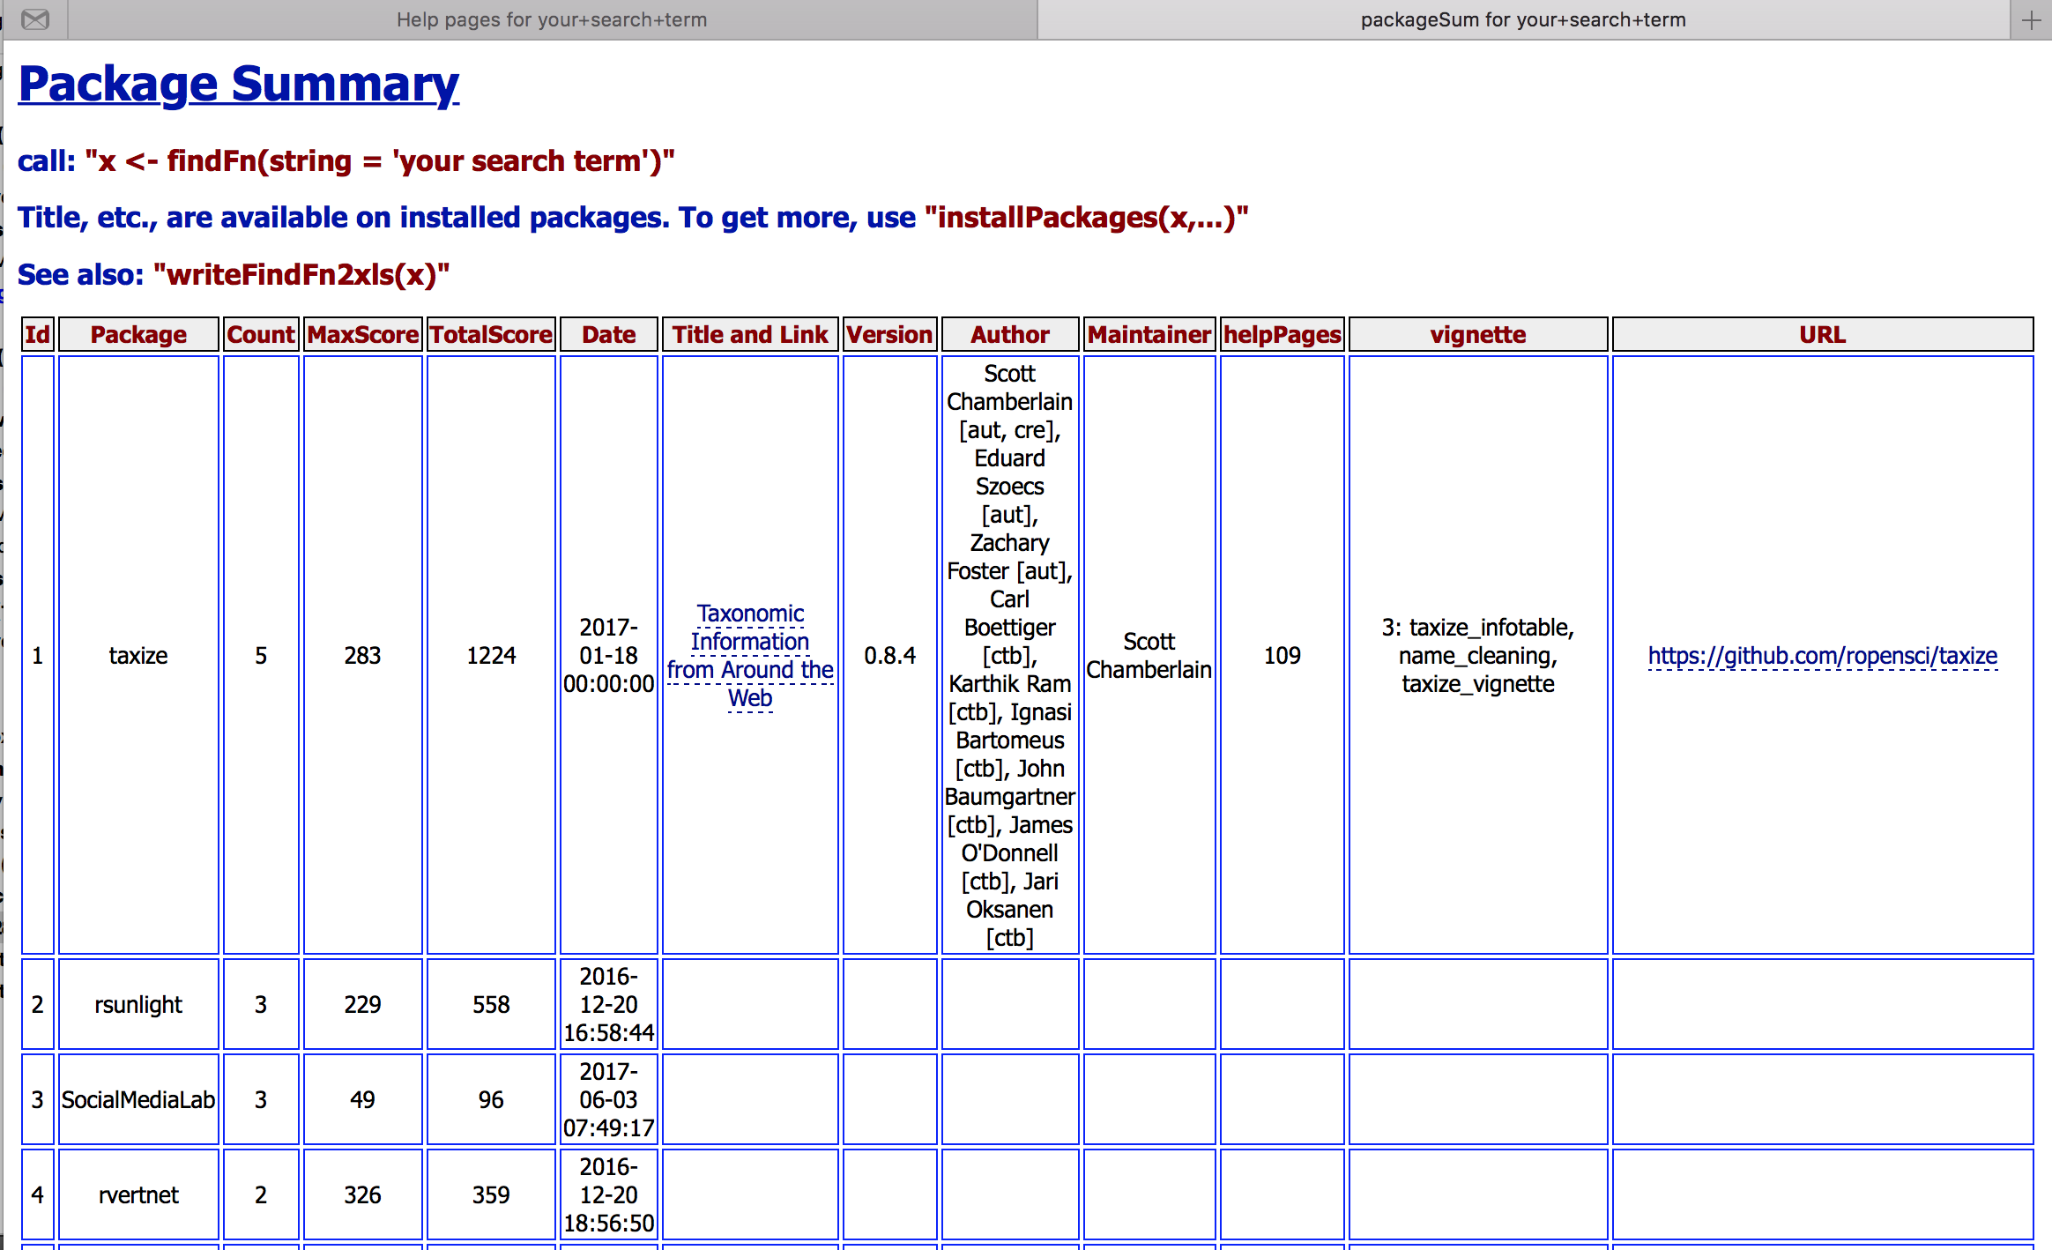
SG

Slide 29


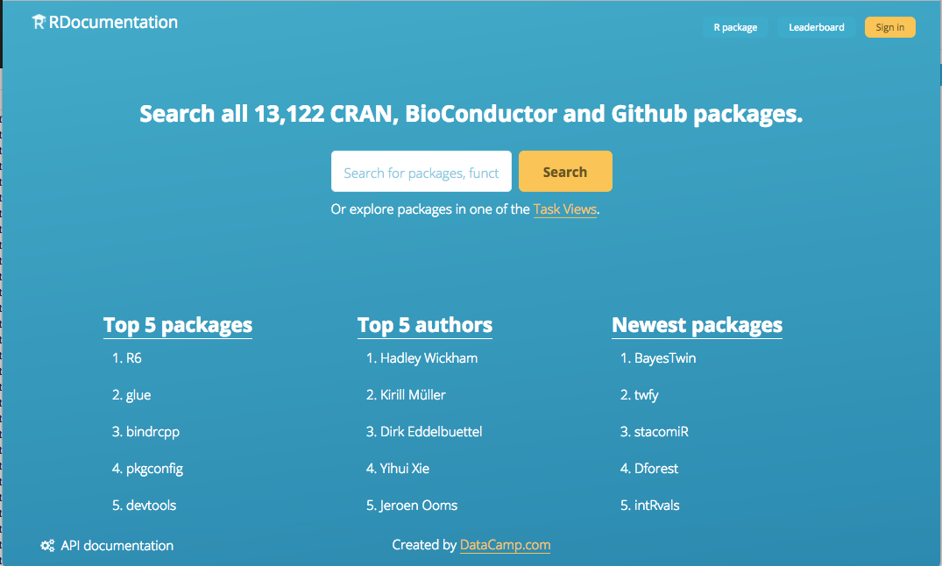
RDocumentation
Online search and discovery tool to navigate all packages on CRAN, BioConductor and GitHub
Navigating R Packages | useR! Brussels

Slide 30
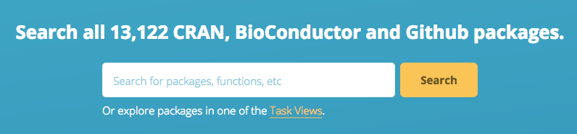
RDocumentation: Why ?
Why did we build this ?
> 13,000 packages
Make it easy to just find what you need
Documentation is written by experts for experts
Provide a user-friendly, welcoming interface for R beginners
Community-driven documentation via examples
Central documentation repository (CRAN/BioC/GitHub)
Find older versions of packages
Navigating R Packages | useR! Brussels

Slide 31









RDocumentation: How ?
How does it work ?
CRAN
Search new packages
Parse package’s doc to HTML
RDocumentation App
Navigating R Packages | useR! Brussels

Slide 32
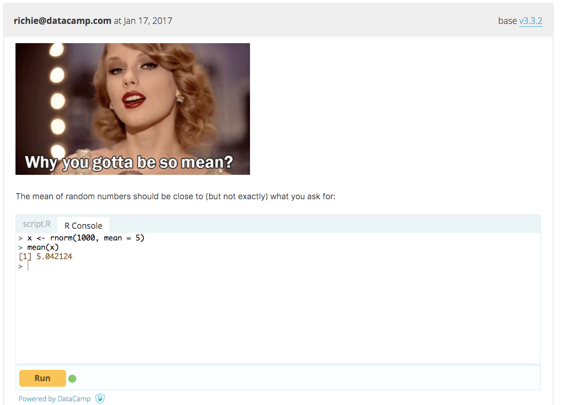
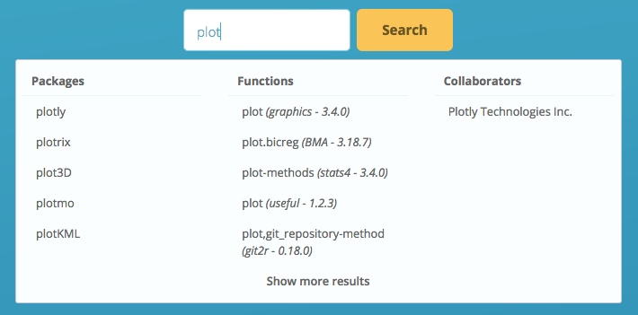
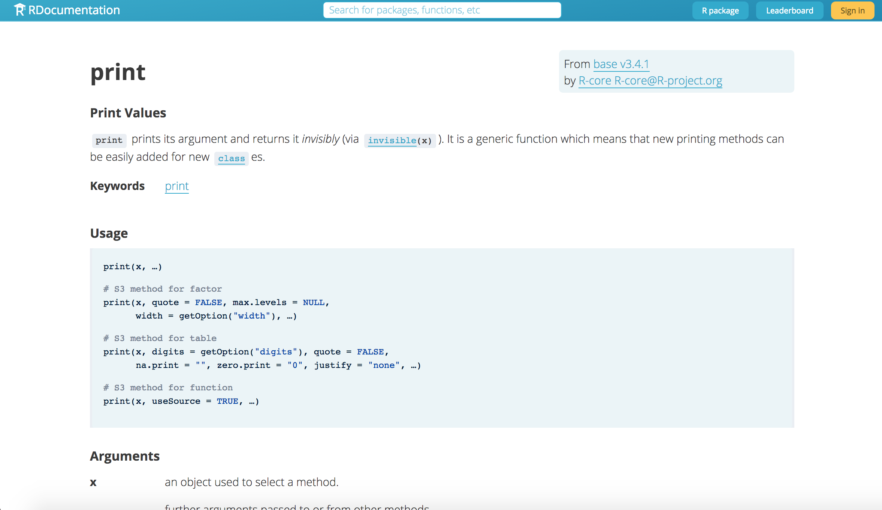
RDocumentation: What ?
Search
2. Content
3. Community
Fast
Precise
Relevant
Use download stats to assess package quality
Up to date
Easy to browse
Visually clear
Older versions are browsable
Community members can post high-quality, interactive examples.
Leaderboard
Navigating R Packages | useR! Brussels

Slide 33
RDocumentation
Where is this going ?
Browse source code
RDocs Light
“Hover” widget to include minimal version of the doc on any website
Increase community engagement
Some contributors post examples but that’s not enough
Want would you want to see ?
RDocumentation is completely open-source!
Wanna help ? Feel free to contribute and post new issues/ideas on:
https://github.com/datacamp/RDocumentation-app
Navigating R Packages | useR! Brussels

Slide 34
Thank you
BREAKOUT SESSIONS
Heather Turner
Tobias Verbeke
useR 2017 organizers
Navigating R Packages | useR! Brussels

